Slide 1


AI Coursework Presentation
Q-Learning with tabular methods using discretized space
Ze Wang
2550208W
Notes:
my topic is about Q-Learning with tabular methods using discretized space

Slide 2
01
Core problem and Environment
Mitigation policies on the spread of the COVID-19 virus
02
Method
Q-Learning with tabular methods
Catalogue
03
Demostration
Evaluation and results
04
Comparasion
To random agent

Slide 3

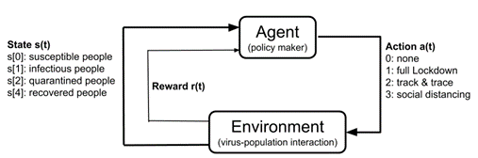
Core problem and Environment
ViRL Environment
An Epidemics Reinforcement Learning Environment
Design the Agent
PEAS Analysis
Performance measure: Maximize the Rewards
Environment: ViRL , four groups of people consitute the state
Actuators : None, full Lockdown, track & trace, social distancing
Sensors: Zero cost

Slide 4

Method
Q-Learning with tabular methods
Model free and represent utilities mapping from states to actions
TD learning, adjusting the Q(s,a)-values.
Procedure:
First selection an action based on Q including exploration
Record the end up state and action s’|a,s
Compute the target value
Compute difference
Update the Q(s,a) to approximate the true value by take a small step (alpha).

Slide 5
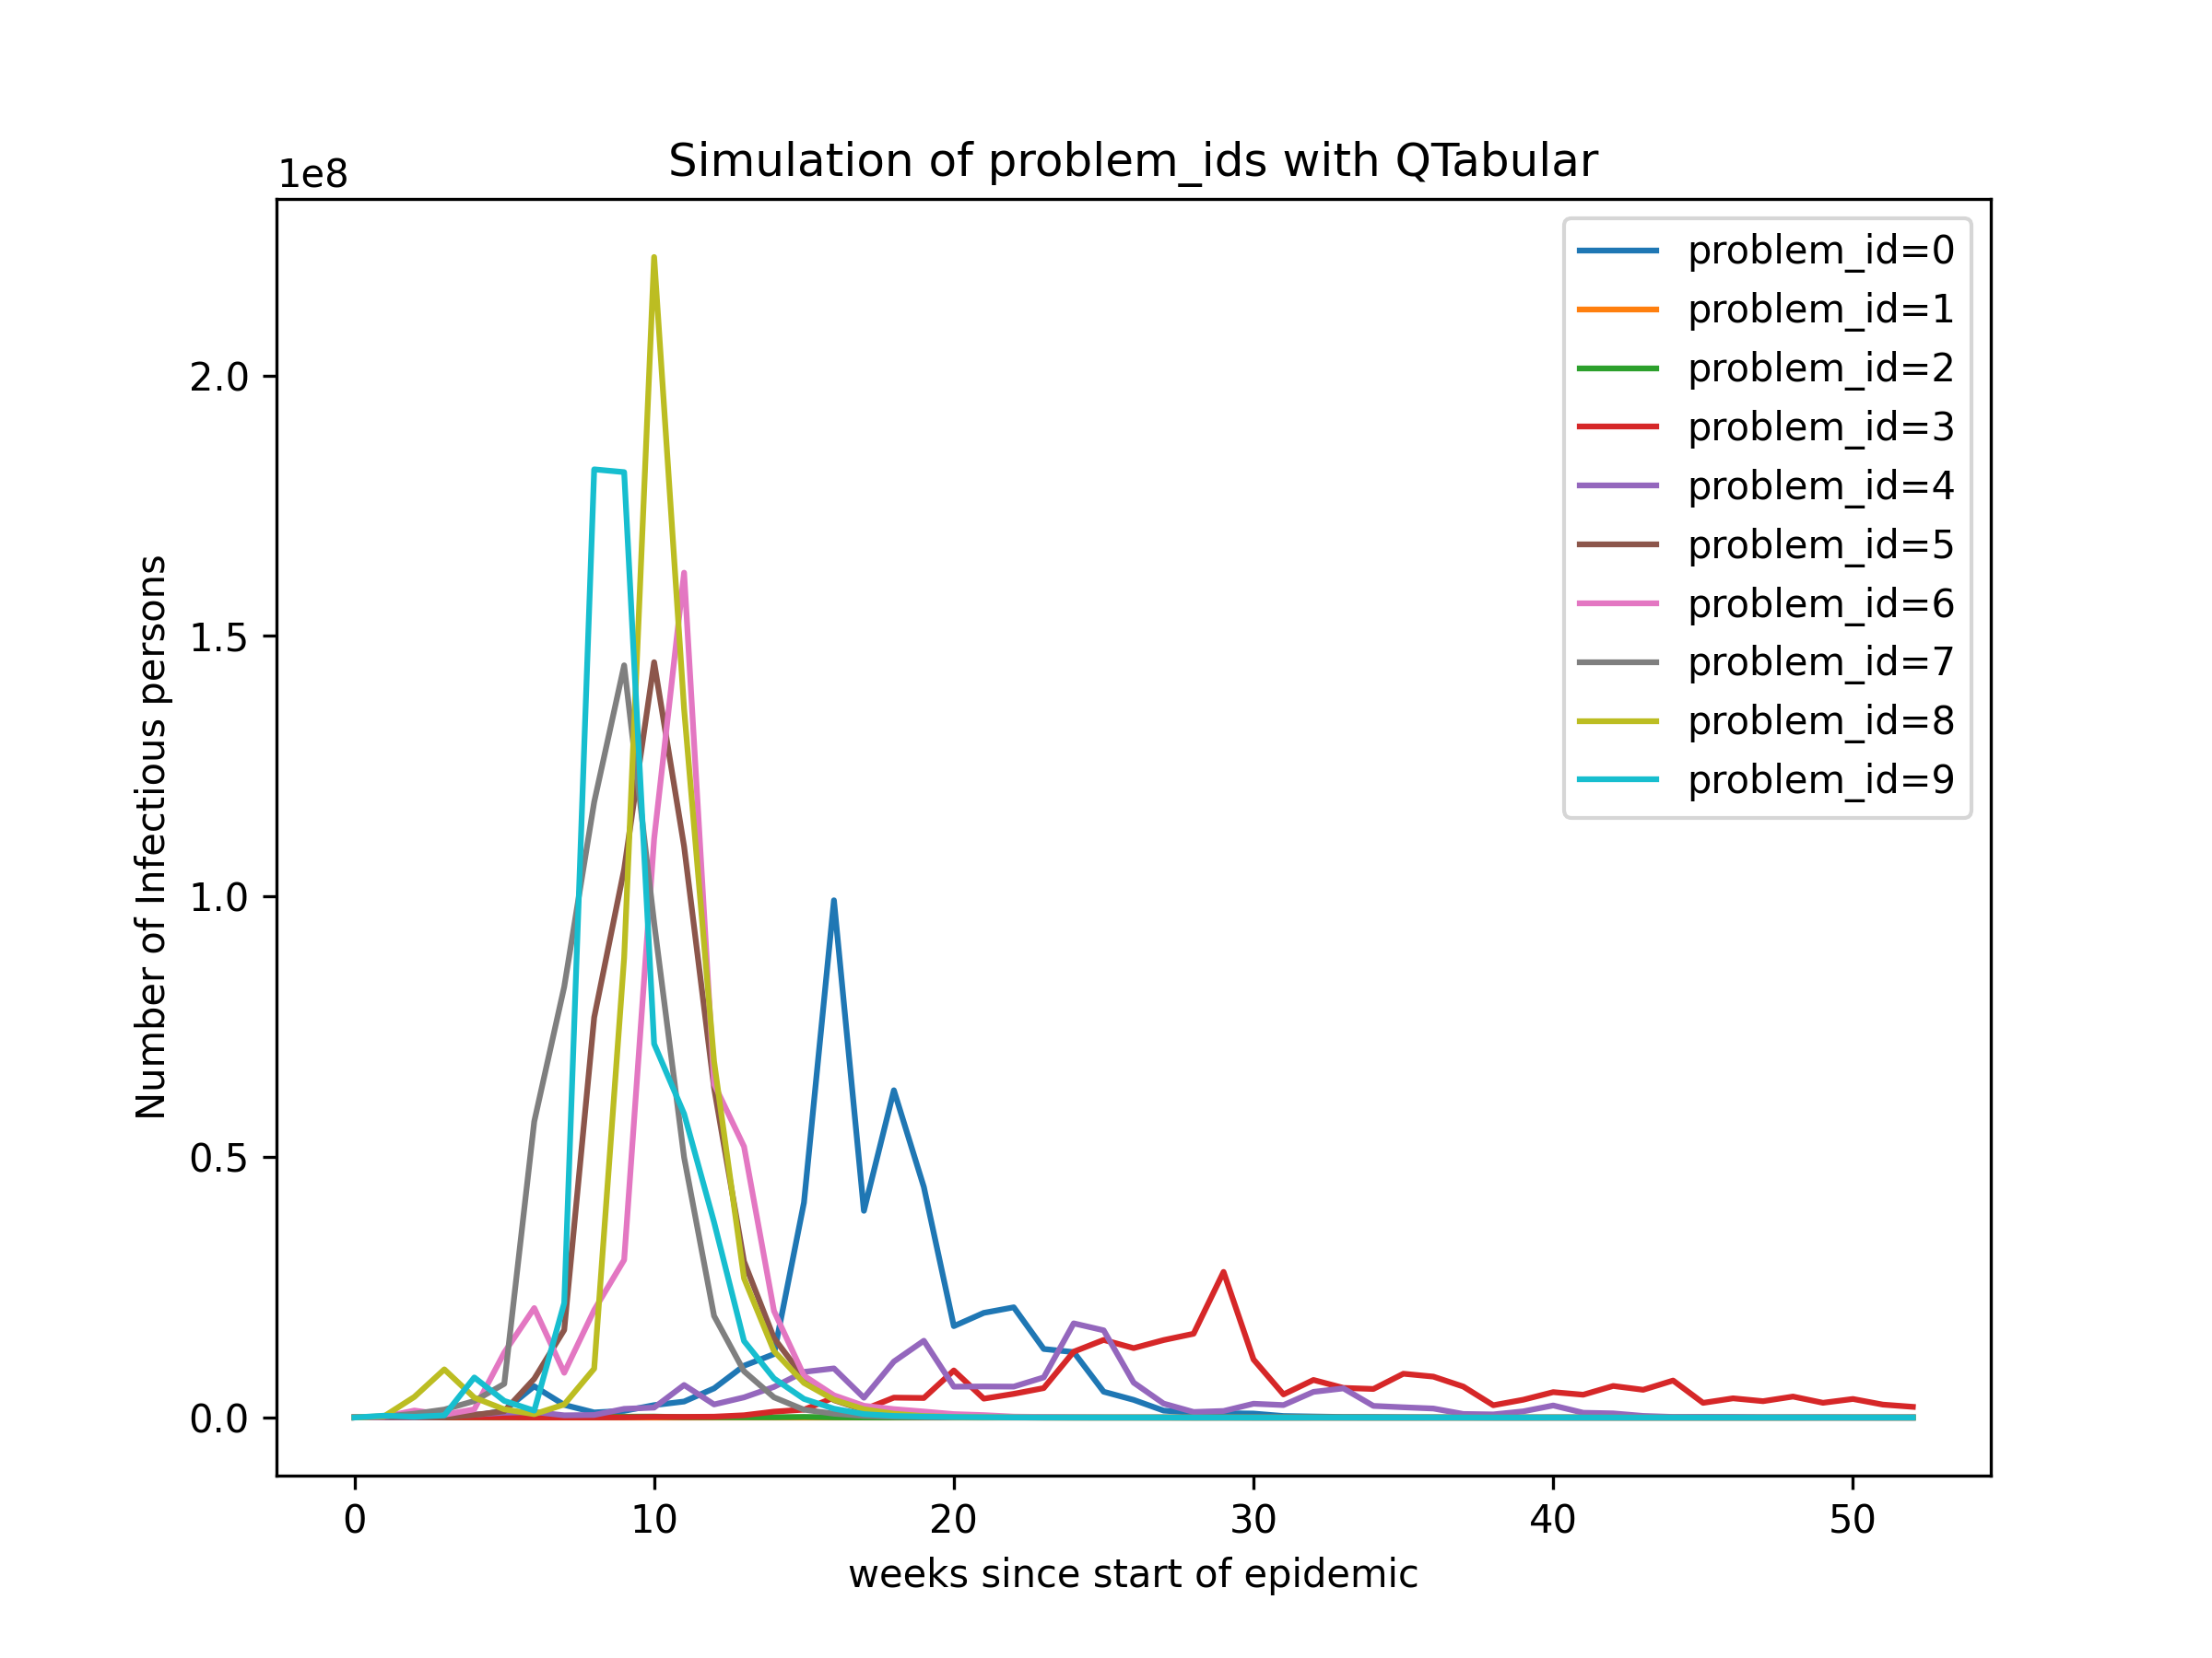
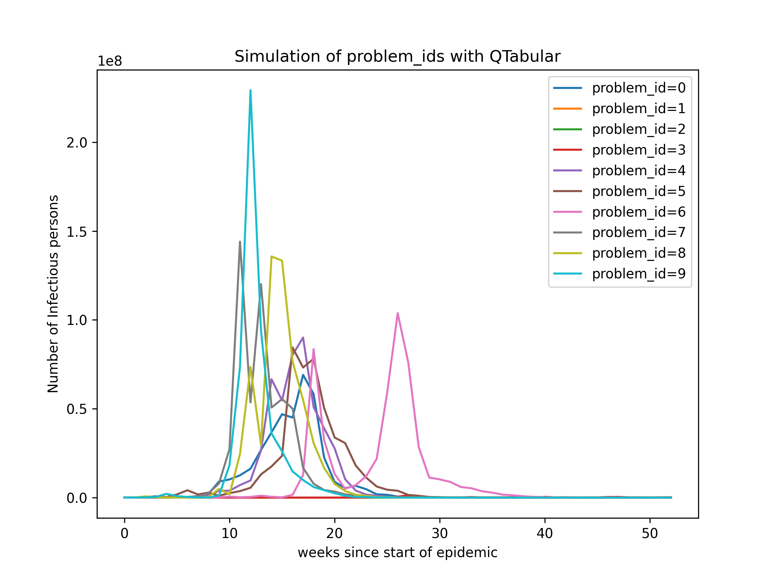
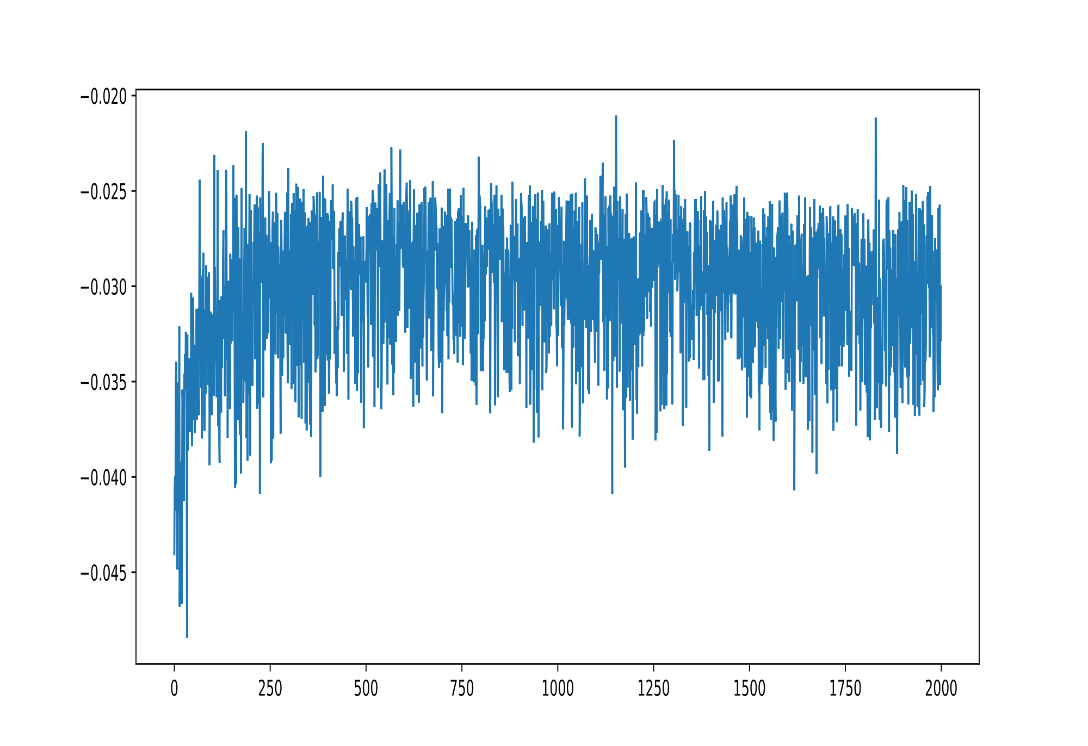
Demonstration
Test on problems with no noise
Test on problems with noise = true
Average Rewards per action over train episodes

Slide 6
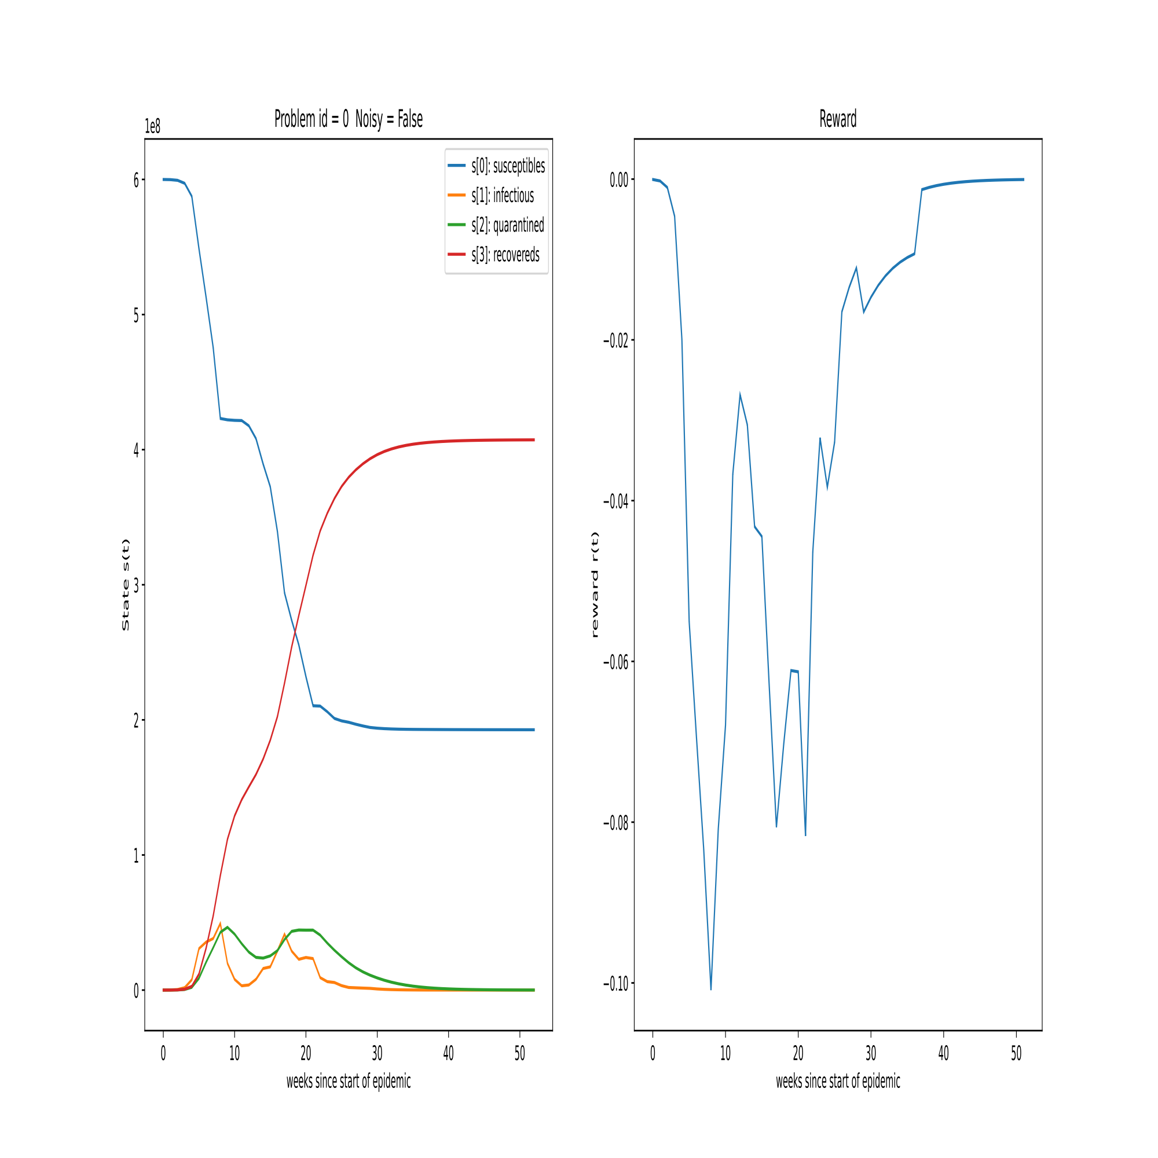
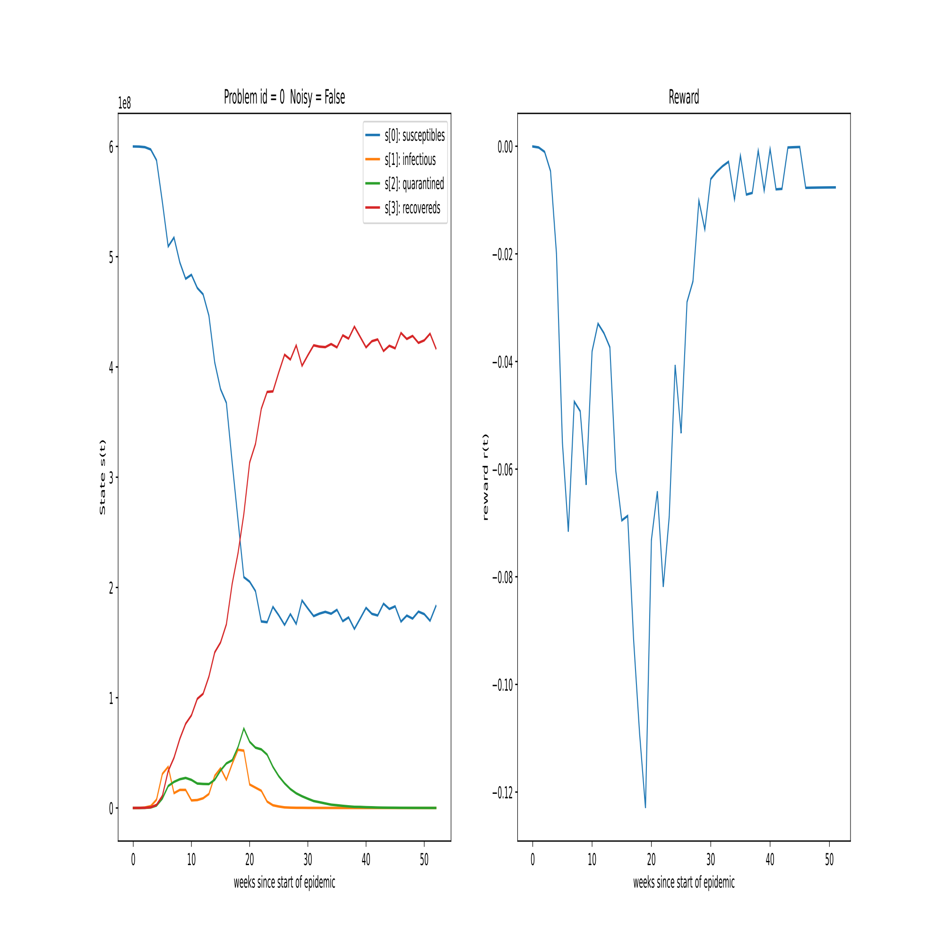
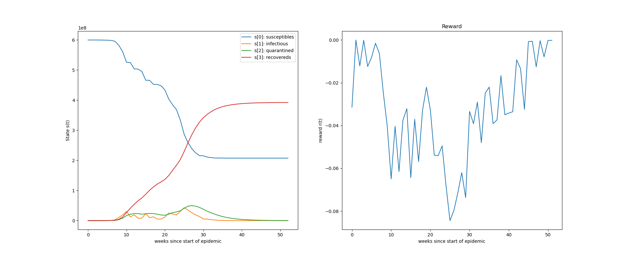
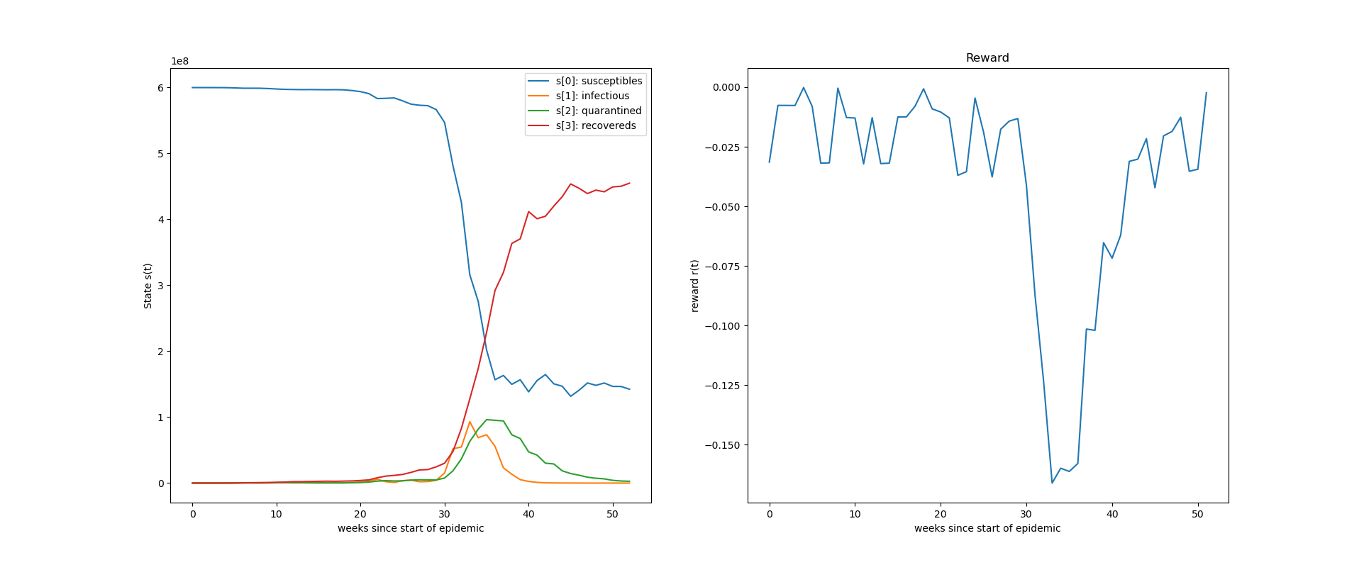
Comparasion
Q agent: Test on problem 0 no noise
Q agent: Test on problem 0 with noise
total reward -1.0416556099706027
total reward -1.035598818310955
Random agent: Test on problem 0 no noise
Random agent: Test on problem 0 with noise
total reward -1.6866119103078427
total reward -2.0536742494358062

Slide 7
Thanks

